Slide 1
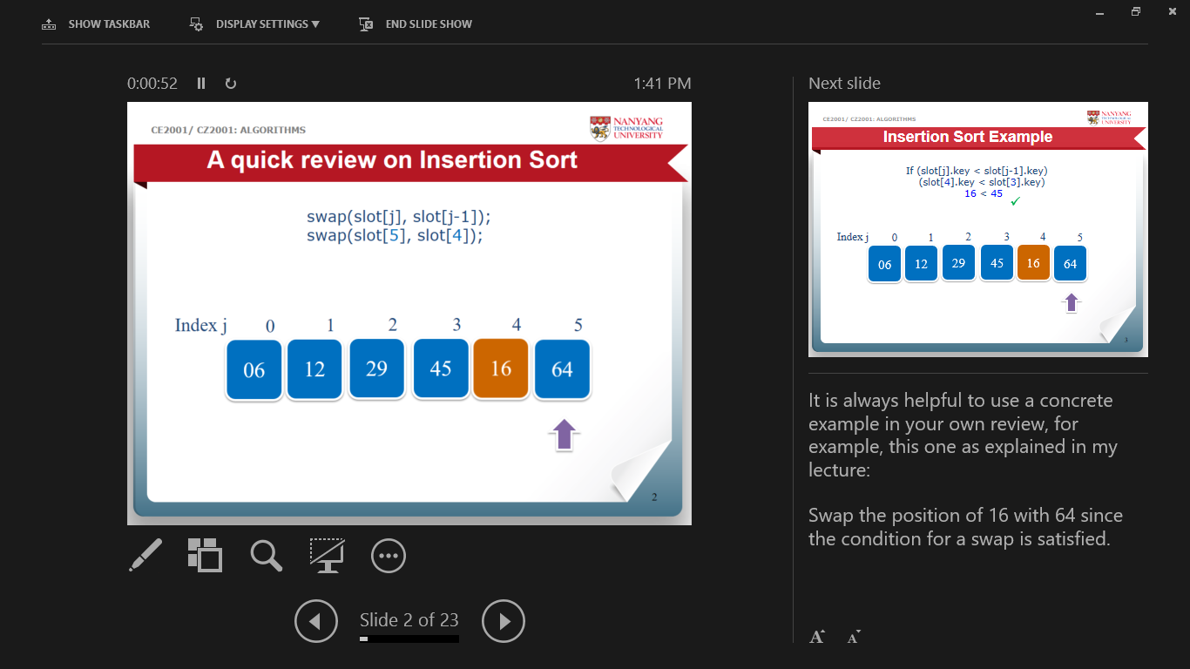
CE2001/CZ2001 Algorithms
Tutorial 3 (Sorting) Q4-6
A special PPT presentation made for eLearning. Play with “Show Presenter View” for the notes like the followings:
Notes:
The animated slide show can better illustrate you the concepts and processes.

Slide 2
A revisit to Quicksort (Example)
0
1
2
3
4
5
6
7
8
9
Start
77
15
96
89
42
80
35
04
93
06
pivot
0
1
2
3
4
5
6
7
8
9
Swap
77
15
96
89
42
80
35
04
93
06
Partition the elements …
Notes:
play forward and backward as you like, to take the advantage of the animated slides.

Slide 3
Quicksort (Example)
Partitioning…
0
1
2
3
4
5
6
7
8
9
42
15
96
89
77
80
35
04
93
06
last_small
i
0
1
2
3
4
5
6
7
8
9
42
15
96
89
77
80
35
04
93
06
last_small
i
Notes:
play forward and backward as you like, to take the advantage of the animated slides.

Slide 4
Quicksort (Example)
Partitioning…
Carry on checking if (item ≥ pivot) …
0
1
2
3
4
5
6
7
8
9
42
15
96
89
77
80
35
04
93
06
last_small
i
0
1
2
3
4
5
6
7
8
9
42
15
35
89
04
93
06
96
77
80
35
last_small
i
Notes:
play forward and backward as you like, to take the advantage of the animated slides.

Slide 5
Quicksort (Example)
Partitioning…
Carry on checking if (item ≥ pivot) …
0
1
2
3
4
5
6
7
8
9
04
06
42
15
35
89
77
80
96
04
93
last_small
i
0
1
2
3
4
5
6
7
8
9
42
15
35
04
77
80
96
89
93
06
last_small
i
Notes:
play forward and backward as you like, to take the advantage of the animated slides.

Slide 6
Quicksort (Example)
Partitioning…
Carry on checking if (item ≥ pivot) …
0
1
2
3
4
5
6
7
8
9
i ++
(93 >= 42)
42
15
35
04
77
80
96
89
93
06
last_small
i
0
1
2
3
4
5
6
7
8
9
Swapped
(06 and 77)
42
15
35
04
06
80
96
89
93
77
last_small
i
Notes:
play forward and backward as you like, to take the advantage of the animated slides.

Slide 7
Quicksort (Example)
Finally, swap “last_small” (i.e. the final position where the pivot should be) with pivot.
0
1
2
3
4
5
6
7
8
9
42
15
35
04
06
80
96
89
93
77
We have done 9 comparisons in the partition.
Notes:
Have a break, confirm the 9 comparisons in the above processes.

Slide 8
Question 4
Suppose that, instead of using E[middle] as pivot, QuickSort also can use the median of E[first], E[(first + last)/2] and E[last]. How many key comparisons will QuickSort do in the worst case to sort n elements? (Remember to count the comparisons done in choosing the pivot.)
Ans:
Consider a subrange of k elements to be partitioned.
Choosing the median as the pivot from E[first], E[(first + last)/2] and E[last] requires 3 key comparisons.
E.g.
0
1
2
3
4
5
6
7
8
9
77
15
44
89
96
80
35
04
93
06
0
(0+9)/2= 4
9
Notes:
It is always helpful to use an example to illustrate the case. E.g. if the middle 96 is directly selected as the pivot in the original Partition routine, after one round of partitioning, 96 will be swapped to the right end, and all the other elements will be in its left; the next round of partitioning will still do a heavy job, right?
With the suggested “median-of-3” strategy, the largest 96 and the smallest 06 will not be unluckily selected as the pivot, and the median 77 is selected as the pivot, resulting in a balanced partition:
{15, 44, 35, 04, 06} 77 {89, 80, 96, 93}

Slide 9
E.g.
It’s easy to arrange not to compare elements that were candidates for the pivot again by swapping them to the extremes of the subrange.
E.g. 06 to left-end, 96 to right-end
Now k – 3 elements remain to be compared to the pivot.
So, eventually 3 + (k – 3) = k comparisons are done by the time partition is finished.
- This is one more than if E[middle] is simply chosen as the pivot (Ignored in computing time complexity).
0
1
2
3
4
5
6
7
8
9
06
15
44
89
77
80
35
04
93
96
0
(0+9)/2= 4
9
Notes:
The resulting partition of the example will be :
{06, 15, 44, 35, 04,} 77 {89, 80, 93, 96},
06 and 96 don’t need to be compared, right?

Slide 10
An example of the worst case might be E[first] = 100, E[first + last/2] = 99, E[last] = 98, and all other elements are over 100.
Then, 99 becomes the pivot, 98 is the only element less than the pivot, and k – 2 elements are greater than the pivot.
The remaining keys can be chosen so that the worst case repeats – that is, we can arrange that the median-of-3 always comes out to be the second-smallest key in the range (the median, so not the smallest!).
Since the larger subrange is reduced by only 2 at each depth of recursion in QuickSort, it will require n/2 calls to partition(), with ranges of size n, n − 2,
n − 4, …, 2 (suppose n is even), then the total number of comparisons is
Add two equations
When n is odd, the total number of comparisons is also about n² /4.
So the worst-case time complexity with the median-of-3 strategy is Θ(n²).
n/2 terms
Notes:
You should now understood how the new partition strategy works.
Let’s derive the time complexity function for the worst case, step by step.
Note: In terms of time complexity, the final result of Θ(n²) is the same as that of the original partition strategy.

Slide 11
Question 5
Each of n elements in an array may have one of the key values red, white, or blue.
Give an efficient algorithm for rearranging the elements so that all the reds come before all the whites, and all the whites come before all the blues. (It may happen that there are no elements of one or two of the colours.) The only operations permitted on the elements are examination of a key to find out what colour it is, and a swap, or interchange, of two elements (specified by their indices).
What is the asymptotic order of the worst case running time of your algorithm? (There is a linear-time solution.)
Notes:
As we are in the topic of Quicksort in which the smaller keys are moved to the left, and the larger ones to the right, try to recall the concepts we learnt in the lecture.
Roughly, we can think of the red being smaller, blue the larger, and the white ones as the “pivot”.
Use a short array to think about the solution …

Slide 12
For example,
Input: Intermediate: Output:
If you read a “red”, exchange it to left, next;
If you read a “white”, next;
If you read a “blue”, exchange it to right, next;
Notes:
Use such a 4-element array to illustrate the idea:
Screening from left to right, each time:
If you read a “red”, exchange it to left, next;
If you read a “white”, next;
If you read a “blue”, exchange it to right, next;

Slide 13
Idea:
Assume the elements are stored in the range 0, …, n-1
At an intermediate step the elements are divided into four regions:
The first contains only reds
The second contains only whites
The third contains elements of colors unknown yet
The fourth contains only blues
There are three indexes: r (last red), u (first unknown), b (first blue)
r
u
b
Notes:
Then, generate more detailed idea …
The index u goes from 0 to larger and larger. Before u are the red and white elements;
The index b goes from n-1 to smaller and smaller;
Until u and b meets.

Slide 14
Algorithm:
Input array E[n]; // index = 0 ~ n-1
u = 0; // index of first unknown
r = -1; // index of last red
b = n; // index of first blue
while (u < b) {
if (E[u] == red) {
Interchange (E[u], E[r+1]);
u++; r++;
}
else if (E[u] == white)
u++;
else { // (E[u] == blue)
Interchange (E[u], E[b-1])
b--;
}
}
With each iteration of the while loop, either u is increased by 1, or b is decreased by 1, so there are n iterations.
Each iteration takes constant time, so the time complexity is linear Θ(n).
r
u
b
Notes:
Then write the algorithm.
Use the example to validate it.

Slide 15
Question 6
Suppose we have an unsorted array A of n elements and we want to know if the array contains any duplicate elements.
(a) Outline (clearly) an efficient method for solving this problem.
Illustration:
duplicate!
Input array A:
6
9
5
3
5
8
Duplicate elements are adjacent
After sorting:
3
5
5
6
8
9
Notes:
Use an example to illustrate idea.
(Other non-sorting methods are also available, see part (c))

Slide 16
Ans:
First, sort the array in increasing (or decreasing) order. Then, do a post-scan of the sorted array to check for equal adjacent elements.
Bool ExistDuplicate(int A[], int n) {
QuickSort(A, n);
for (int i = 1; i < n; i++) {
if (A[i] == A[i-1])
return true;
}
return false;
}
Notes:
Any sorting algorithms can be used.

Slide 17
Question 6
Bool ExistDuplicate(int A[], int n) {
QuickSort(A, n);
for (int i = 1; i < n; i++) {
if (A[i] == A[i-1])
return true;
}
return false;
}
(b) What is the asymptotic order of the running time of your method in the worst case? Justify your answer.
Ans:
The worst-case time for sorting is Θ(n²) using QuickSort. The time for post-scan is Θ(n). Therefore, the overall worst-case running time of the algorithm is Θ(n²).
Notes:
The time complexity is determined by the higher order of sorting algorithm.

Slide 18
Question 6
n = 6
Suppose we know the n elements are integers from the range 1, …, 2n, so other operations besides comparing keys may be done. Give an algorithm for the same problem that is specialized to use this information. Tell the asymptotic order of the worst case running time for this solution. It should be of lower order than your solution for part (a).
Ans: Simply count how many have each key value, using an array of 2n + 1 entries to store the counts.
We can quit as soon as any count becomes 2.
Since we scan the n-elements array once, and each element takes constant time to count, the overall worst-case running time is Θ(n).
6
9
5
3
5
8
Use the key value as index
0
0
1
0
2
0
3
1
4
0
5
2
6
1
2n + 1 entries
7
0
8
1
9
1
10
0
11
0
12
0
Notes:
So, be flexible, if you are not limited to use a specific approach like sorting.
This is a typical Space-Time trade-off approach; using a larger memory to reduce the time complexity.

